Slide 1

Multi-Tenant Application using Spring Boot 3
Abhishek R Bhat

Slide 2
What is Multi-Tenant Applications
Multi-tenant applications using Spring Boot are designed to serve multiple customers (tenants) with a single instance of the application, ensuring data isolation, security, and efficient resource utilization.

Slide 3
How Does Multi-Tenancy Work?
Tenant Isolation: Each tenant has their own space for data.
Data Sharing: The application is shared, but the data is private to each tenant.
Customization: Different tenants can have their own settings or data.

Slide 4
Multi-Tenant Strategies
Database-per-Tenant: Each tenant has a separate database. This offers the highest level of data isolation but can be complex to manage.
Schema-per-Tenant: Each tenant has its schema within a single database. This balances isolation and complexity.
Shared Schema:
All tenants share the same database schema with tenant-specific data differentiated by a tenant identifier. This is the most resource-efficient but requires strict tenant isolation at the application layer.

Slide 5
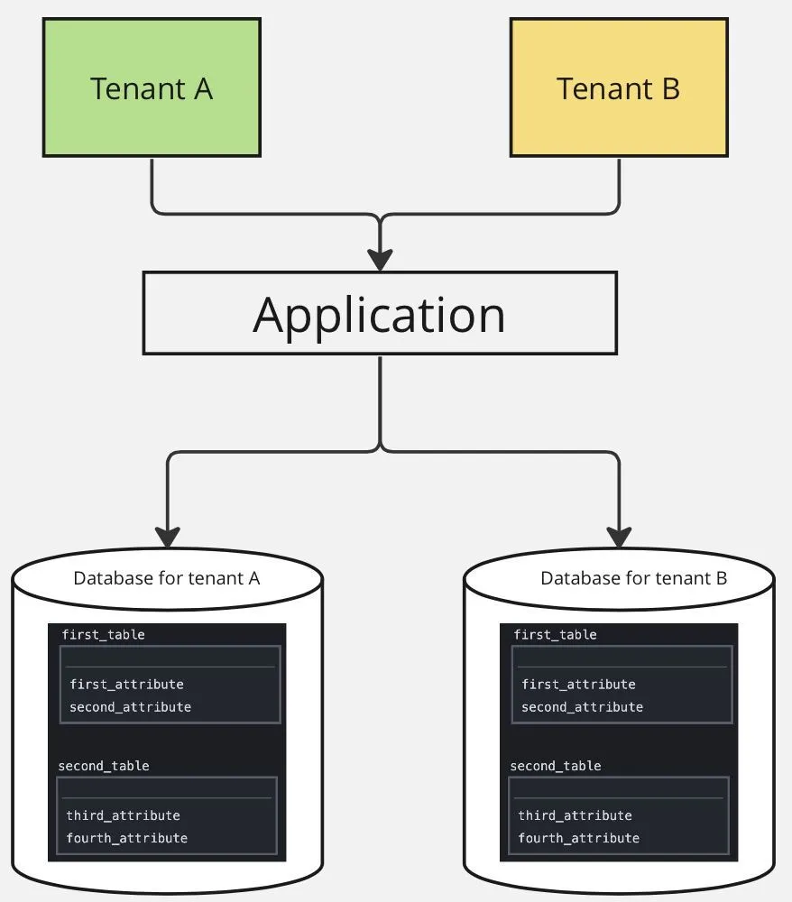
Database-per-tenant
Advantages:
Better database performance
Best data separation
Disadvantages:
The most complicated in development.
In case of using different database instances — the highest infrastructure price

Slide 6
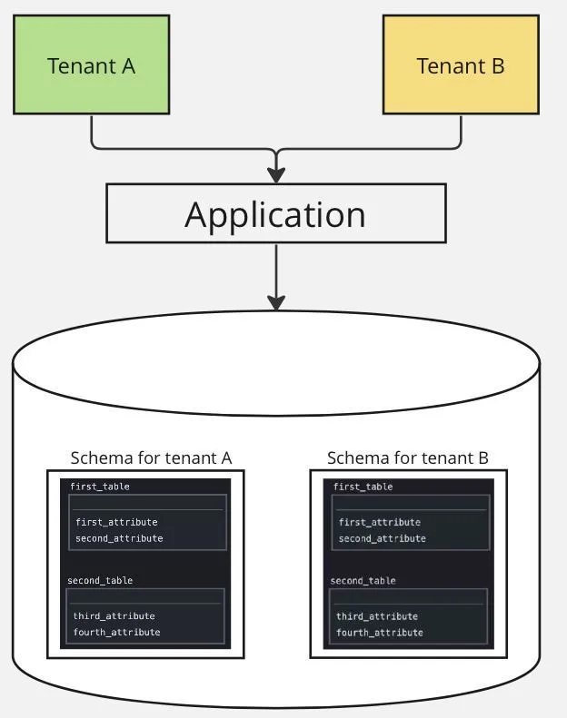
Schema-per-tenant
Advantages:
Better database performance
Better data separation
Disadvantages:
More complicated in development

Slide 7
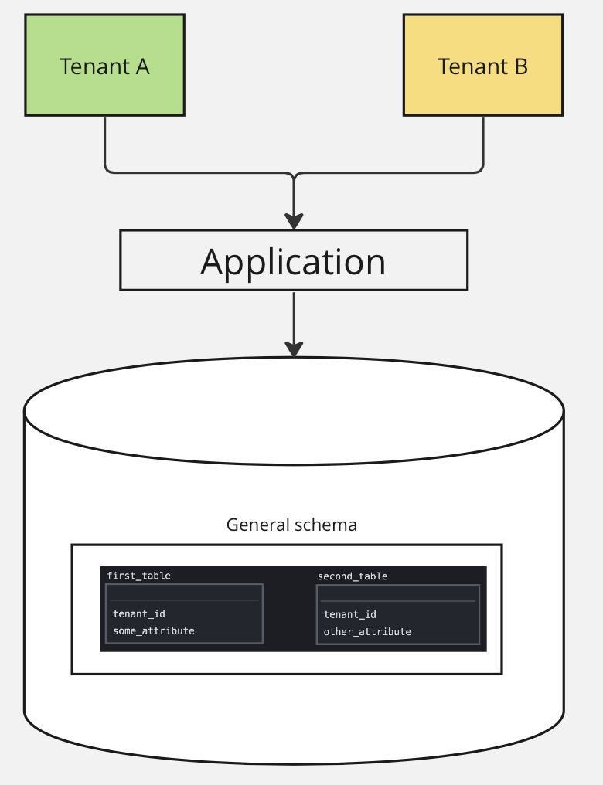
Shared Schema
Advantages:
Best development simplicity
Low infrastructure cost
Disadvantages:
Worse database performance

Slide 8
Challenges with Multi-Tenant Applications
Keeping Data Safe: Ensure tenant data is not mixed up.
Handling Performance: Make sure the app runs smoothly even with many tenants.
Allowing Customizations: Let tenants customize their experience without affecting others.

Slide 9

Real – Life Applications
Salesforce
Microsoft Office 365
Google Workspace
Amazon Web Services (AWS)
Slack
Workday

Slide 10
Thank You

